Slide 1

Does Vaccine Help the Economy?
Group 2
Notes:
Hi everyone, we are group 2 my name is Lynne. Yen, Jonna, Lilian, Sandy and I would gonna talk about “Does vaccine help the economy”.

Slide 2
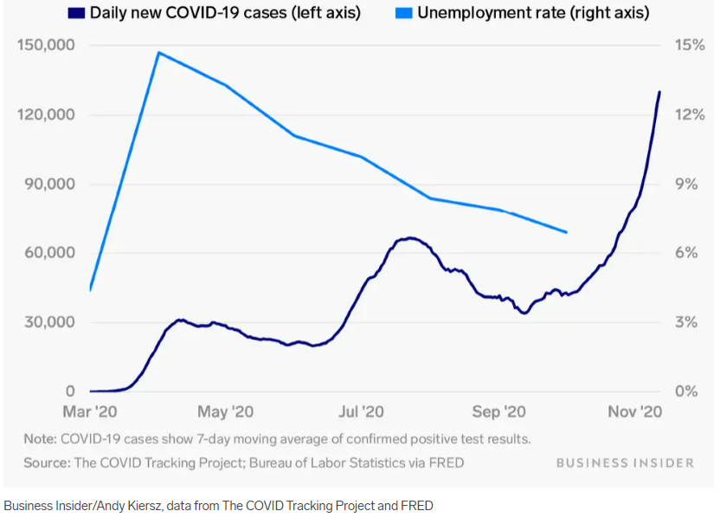
Lynn
U.S. COVID-19 cases and unemployment
Notes:
As everyone knows that the pandemic broke out seriously at the spiring in 2020, which reaches the peak of the unemployment rate in April. (As you can see the red circle on the slide)
It was the highest rate observed since 1948.
The cases increased as time goes by 2020, however, the unemployment rate has kind of slow down afterward.

Slide 3
Lynn
“Vaccines are absolutely, 100 percent the answer to economic challenges imposed by the pandemic.”
Economics Professor Jonathan Me
Notes:
While the cases were increasing, an economics professor stated that “………….”
We stay skeptical of this statement so we analyzed the vaccination rate data and the unemployment rate data, since we assumed that the unemployment rate data could be an index reflecting the prosperity of the economy.

Slide 4
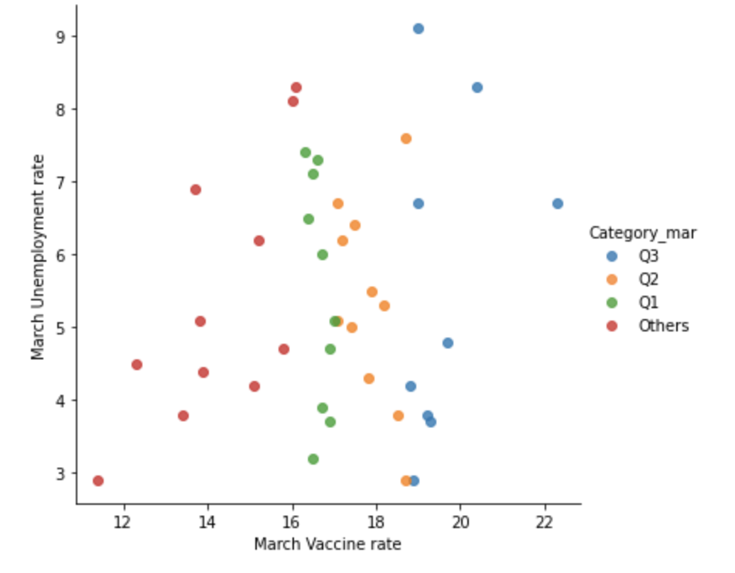
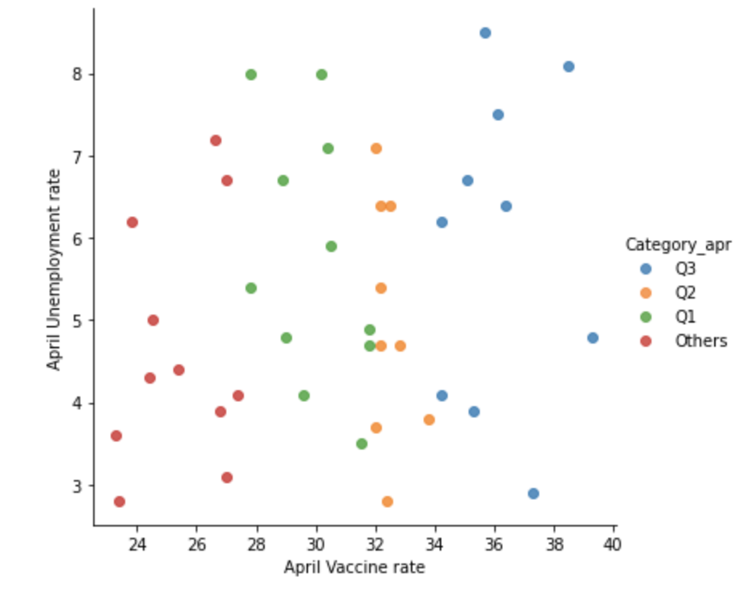
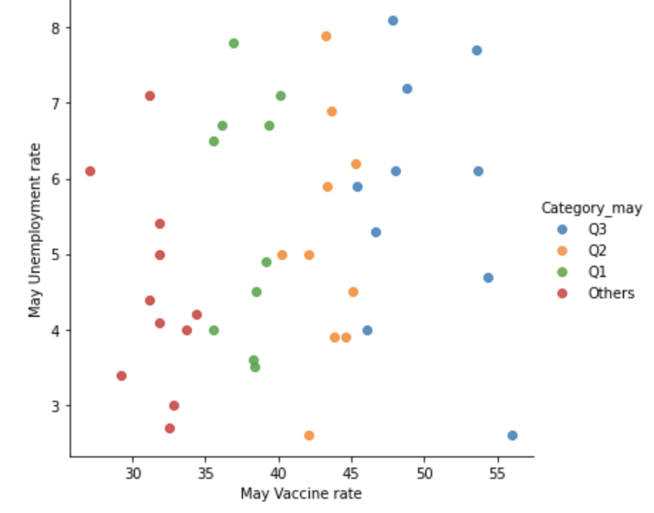
Lynn
Scatter Plot by states
March
April
May
X-Axis : Vaccination Rate
Y-Axis : Unemployment Rate
Notes:
Then we first used Scatter Plot trying to initially understand the overall relationship between the unemployment rate and the vaccination rate.
We categorized the states using quartile based on the vaccination rate ranked in each month, making the graph easier to read.
We expected that highly vaccinated states would have a lower unemployment rate
It means that the blue dots which represent states that have a higher vaccination rate should be spread closer to the zero baseline.
However, as you can see no matter which category we select, the unemployment rate of each state scatter from high to low.
So briefly we can’t clearly tell the relationship by using the scatter plot

Slide 5
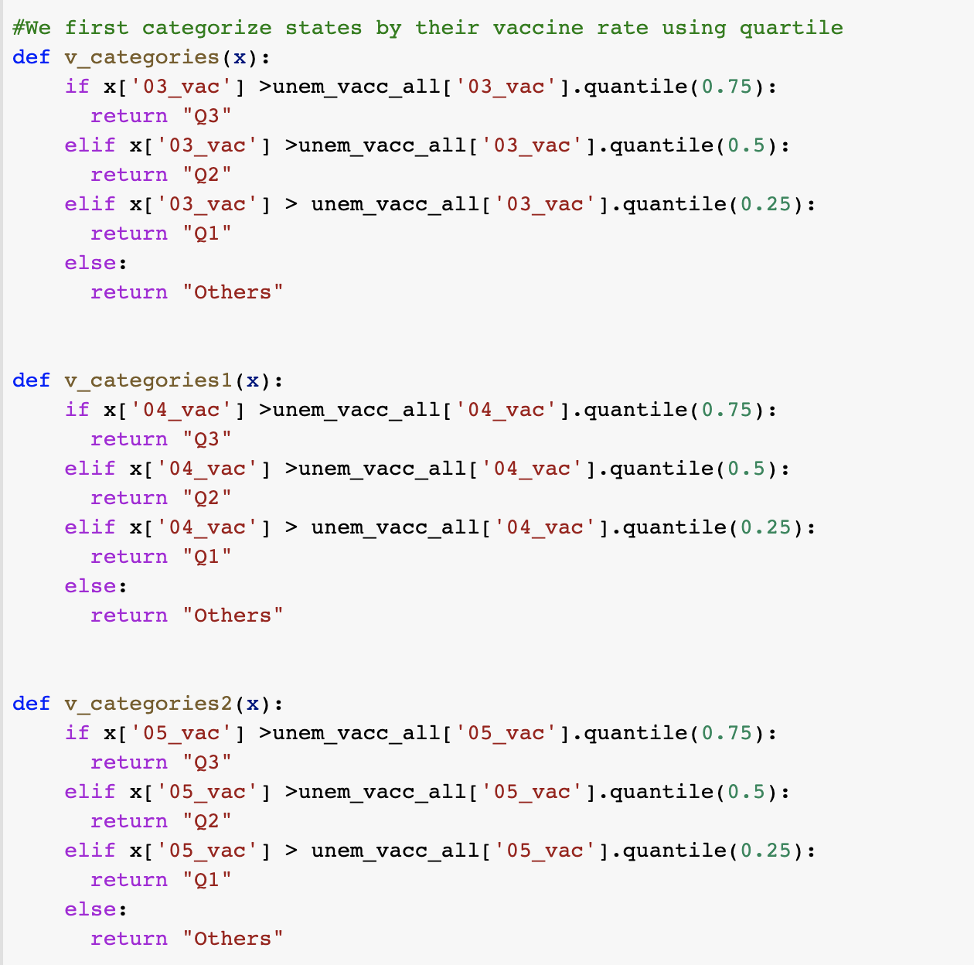
Categorizing States Using quartile
Lynn
Notes:
This is the coding part of categorizing states using quartile, we defined the rates of each month using conditional and quantile function to sort the 75% 50% 25% part, or else it would be included in the “other” part. Then we draw the data using seaborn.

Slide 6
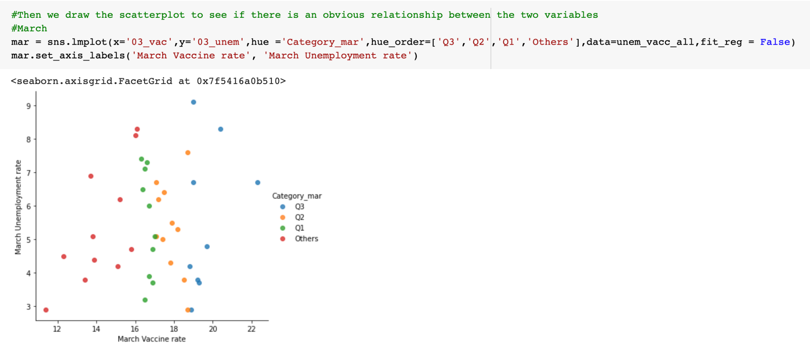
Lynn

Slide 7
Overall Analysis Framework
Jonna
1
DATA CLEANING BEFORE SAMPLING
2
DATA CLEANING BEFORE VISUALIZATION
3
DATA VISUALIZATION USING MATPLOTLIB
Notes:
Because we can’t see any trend and relationship in the previous scatter plot, we plan a well-knit analysis framework for our project.
The framework is consist of three main part:
The first part is Data Cleaning before sampling, we will do some cleaning and choose the target data we want to focus on.
The second part is Data Cleaning before visualization, in this part, we Merge, Retrieve and transpose data to make sure data is good enough to do the visualization.
Lastly, we do data visualization using matplotlib. We exclude irrelevent data in this part so that we can see the trends in the graph.

Slide 8
Sampling Criteria
Jonna
1
Population
U.S. States
2
Similar Economic Development
Top 25 in State GDP
3
Similar Reported Covid cases
Top 5 in Case Rate per 100,000
Notes:
In order to prevent selection bias for our analysis, several sampling criteria were set in the data cleaning part
In the Onion chart, you can see each layer represent those condition.
Firstly, data were based on U.S. state populations
We then use state GDP in 2020 as a filter to make sure our analysis candidate is on similar economic development
Furthermore, we use Covin Case Rate to prevent the distortion among the population of each state. And we finially find top 5 target state we will to analyze in the project.

Slide 9
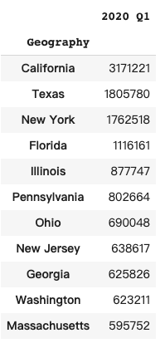
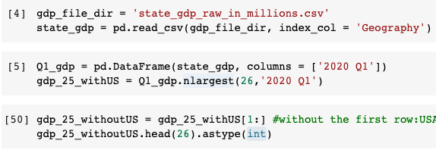
States Filtered by GDP Data
Yen
Ensure the economic impact can be directly observed.
Choose similar GDP state to avoid other factors that may cause economic index bias.
Notes:
So now we will use the GDP to opting the former 50% state as our choosing pool. Why is GDP? Cause we want to ensure the economic impact can be directly observed. Also to avoid any other factor that will cause a bias to the economy index. We use the data from the state economic monitor, which includes US GDP information. The first step is to read the file and set the Geography column, representing the state name, as the index column.Later on, we need to set up a benchmark of GDP. Because the pandemic begins in 2020 Q2, so we use column function to choose only the 2020 Q1 GDP as our criteria. As the picture shows. Then we use nlargest function to arrange the state GDP and select the top 50% state as our candidate state. Then we build a new variable that stores the data only from the second row to the end. Because the first row is the data for the United States, not by the state, so we remove it. Also, we transit the float into integer to better visualize our data.

Slide 10
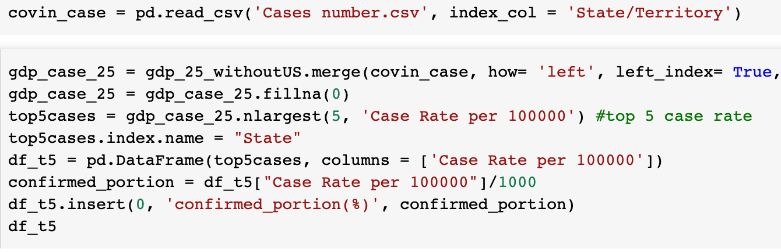
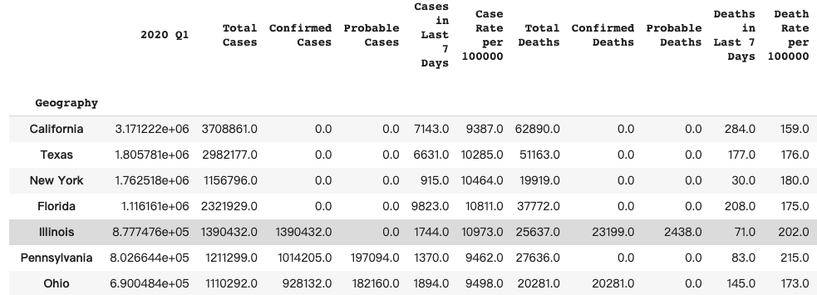
Covid Cases Rate Merged with Candidate
Yen
Notes:
The second step is to read the covid case. We found the information from CDC and we set the State/Territory as the index column. Then use left join to merge it with our previous statement, the 25 candidate states. Also, we use fillna function to replace all the NA values with zero.

Slide 11
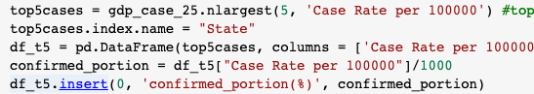
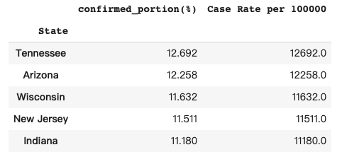
Top 5 States Extracted
Yen
Notes:
Then we need to choose five states to focus on. So we use nlargest function to rank again. This time the ranking factor is the case ratio. Which means we pick up five most severe state among our candidate. Because we need to merge this file later, we also change the index name into “State”. Recalculate the confirmed case portion by state and insert as the first column to better visualize the percentage of confirmed cases.

Slide 12
The Selection of the 5 States
Yen
Wisconsin
New Jersey
Indiana
Arizona
Tennessee
Notes:
The five states are Tennessee, Arizona, Wisconsin, New Jersey and Indiana.

Slide 13
Comparing Factor Import
Unemployment Rate
Reflect short-term economic situation
Related to person
Vaccination Rate
Notes:
We have target.
Then need two dataset to observe if the vaccination rate do affect the economic circumstances?
So we choose two index first is unemployment rate and next one obviously is vaccination rate.
We choose unemployment rate as our economic index, because we assume it can reflect short term economic situation. Also, because COVID is directly impact human being and the unemployment rate is the most related to people than other economic index such as GDP or CPI.

Slide 14
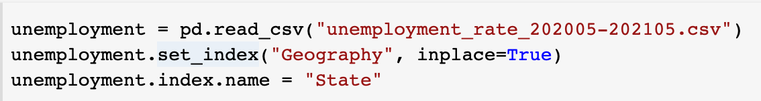
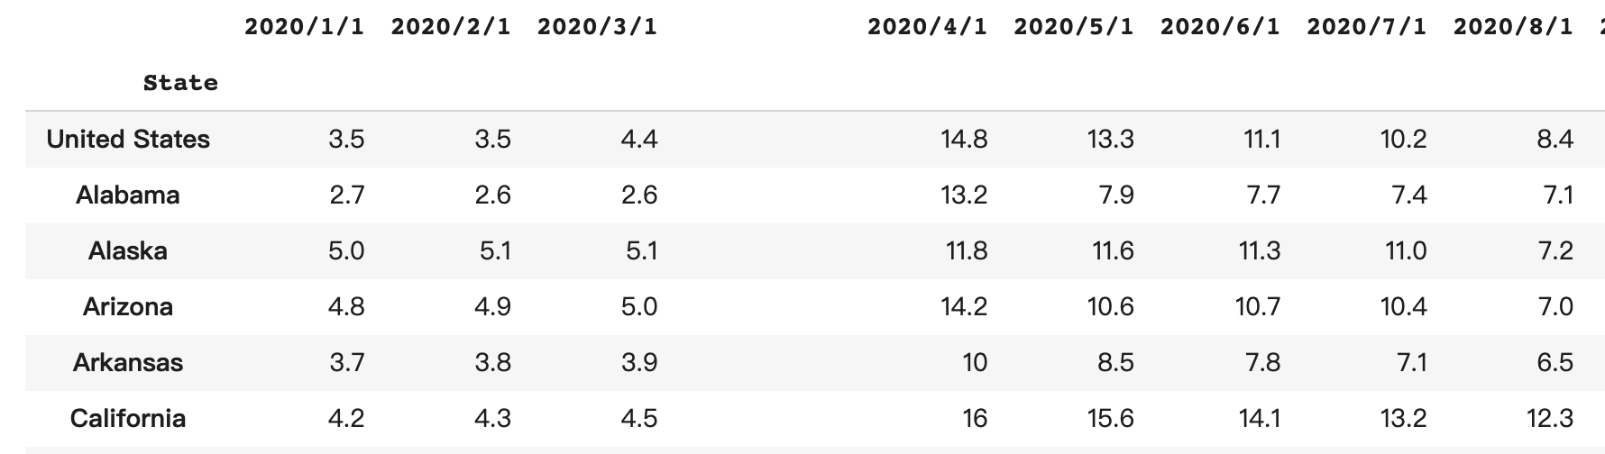
Unemployment Rate Data Import
Notes:
So we start to import the unemployment rate by state, and set the index column by State also named after the column as State to satisfy the merged condition.

Slide 15
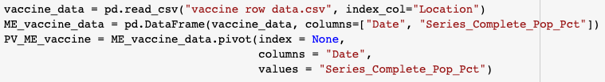
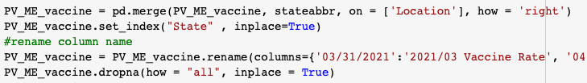
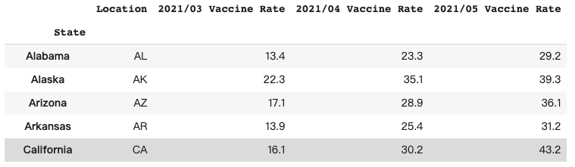
Vaccination Data
Yen
Extract Specific Date Information
-> Pivot
Data Merge & Cleaning
Notes:
Then we start analyzing vaccination data. We set the Location as index column. Because the dataset is a daily accumulation so we use the pivot function to choose a specific date. Because the Location from the original dataset is only abbreviation by state. So we insert the state name by merge function with abbreviation list to ensure we can merge this data with our other dataset. We also clean the NA data in the data set. Now we have vaccination data and the five most harsh states. We can now start to merge our dataset together to visualize.

Slide 16
Data Cleaning Before Visualization
1
2
3
Merging Datasets
Unemployment Rate Dataset
Vaccination Rate Dataset
Retrieving Specific Data
Filter the Top 5 states
Rename and Extract Specific Columns
Transpose
Switch Row to Column making vaccination and unemployment rate in the same column
Notes:
圖表合併欄位：data formating (for merge) ->（data source 是分開的）-> 為了資料呈現需求，讓同個資料表有兩個變數
新增月份欄位：將原本資料欄位切割，成月份資料，新增月份欄位
轉換型別：從 object 改為 int
Explain why the columns were renamed
Before we can start our data visualization, we need to first process and clean the dataset.
We took several steps.

Slide 17
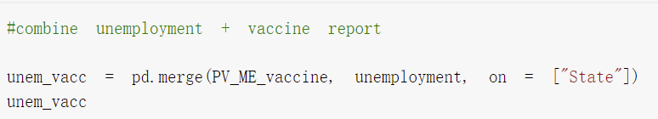
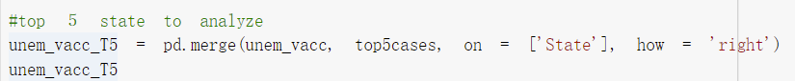
1
2
3
Merging Datasets
Retrieving Specific Data
Transpose
Notes:
First, we merge the dataset.
We combine the unemployment rate with the vaccine rate. So that we can have a dataset with both information on it. And then, we combine the dataset we just generated gain, with another dataset we generated in the previous steps, which is the top 5 cases one.
And we did it because, just as we previously mentioned, in our group project, we mainly want to dig into more details of the 5 states with higher GDP and more COVID cases.

Slide 18
1
2
3
Merging Datasets
Retrieving Specific Data
Transpose
Notes:
And the second step, we retrieved specific data from the dataset we just generated.
Because we only need part of the columns from the dataset, which are the unemployment and vaccination rates.
Before we officially retrieve data, we first renamed the columns to simplify our following processes. For example, we simplified the 2021/03 vaccine rate column name to become 03_vac.
In this way, the column names are shorter but still clear.
Next, we extract the columns we want in a very simple way, by just calling the column names we want to have.

Slide 19
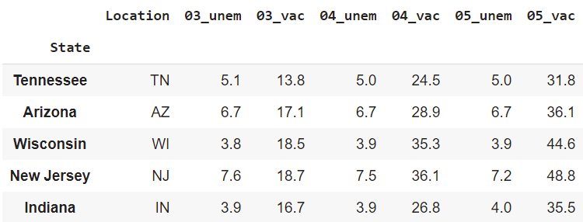
1
2
3
Merging Datasets
Retrieving Specific Data
Transpose
Notes:
After the first and second steps, here’s the dataset that we currently have.
You can see, on your left hand side, the states are listed as the index of the dataset.
And we also have the unemployment and vaccination rate listed by columns.
One thing you might notice is that, we only have the data from March to May.
That’s because, before March, the US government did not distribute many vaccines to each state. So on the dataset provided by CDC, most states has 0 vaccination rate before March.
That’s why we only retrieve data from March.

Slide 20
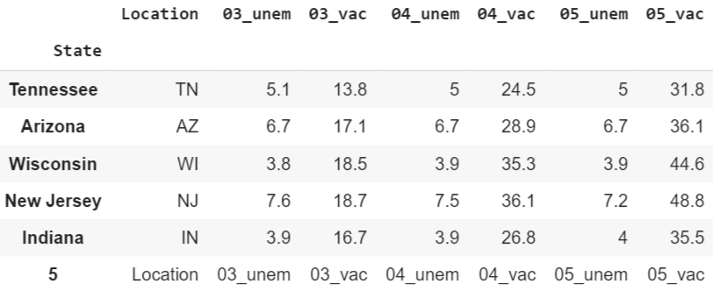
1
2
3
Merging Datasets
Retrieving Specific Data
Transpose
Notes:
Next, we need to transpose our dataset.
That’s because we want to make draw the charts by state, so that we need to make sure the unemployment rate and vaccination rate of the same state is under the same column.
Before that, we did one more thing.
That is, we added the original column names as a new row at the bottom of the original dataset.
That is because after we transpose the dataset, the original column names will become the new index of the table.
However, we dont want that. We hope it can become a new column in the new dataset, so that we can further process it.
We will explain what we are going to do later on.
But I can give you the general idea here.
For example, we will definitely want to separate the month from unem or vacc of the column names.
That’s why we added the new row.

Slide 21
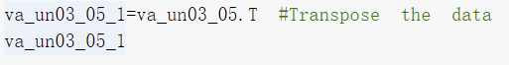
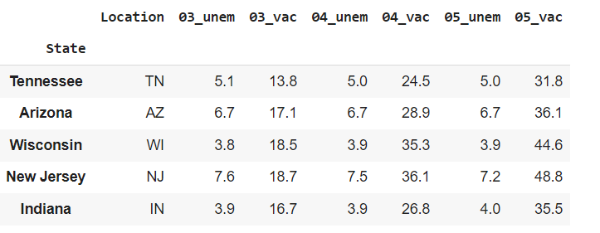
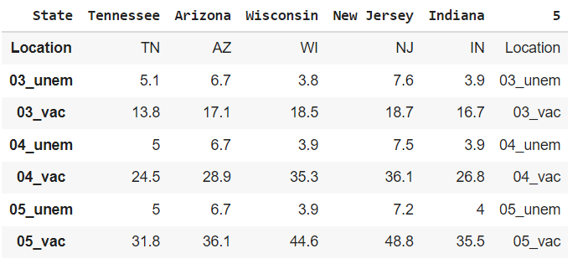
1
2
3
Merging Datasets
Retrieving Specific Data
Transpose
Notes:
And after we added a new row, we just transposed the dataset using the.T function of python.
Now, we have the before and after dataset to compare with.
You can see, in your right hand side, the unem and vaccination rate of the same state is now listed in the same column.
And the row we added in the original dataset is now the last column of the new dataset.
Ok! So we have done the preprocessing of our dataset.
Next, we are going to visualize our data!
9:20

Slide 22
Data Visualization Using Matplotlib
1
Extract States one at a time
2
Split Columns (Month/Type)
3
Exclude Irrelevant Data
4
Rename & Convert Data Type of the Column
5
Separate Vac and Unem
Notes:
Now we already have a dataframe of vaccination rate and unemployment rate from March to May in these 5 states.
So, in order to figure out the exact relationship between these two variables in individual state, we use Matplotlib to create line plot. We took 5 steps to visualize it, those are extraction, splitting, exclusion, rename and conversion, and separation. Let’s go through every step with the following example: Tennessee.

Slide 23
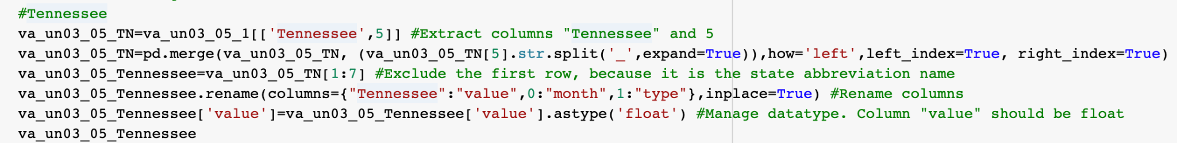
1
Extract States one at a time
4
2
Rename & Convert Data Type of the Column
Split columns (Month/Type)
5
Tennessee
3
Separate vac and unem
Exclude Irrelevant Data
Notes:
First, we extracted “Tennessee” from the dataframe, and we also need column “5”, which is created to differentiate our two variables, as we explained it before.

Slide 24
Notes:
And before we move on, let’s look back on our dataframe, what we extracted are the left side column in blue, and right side column in red.

Slide 25
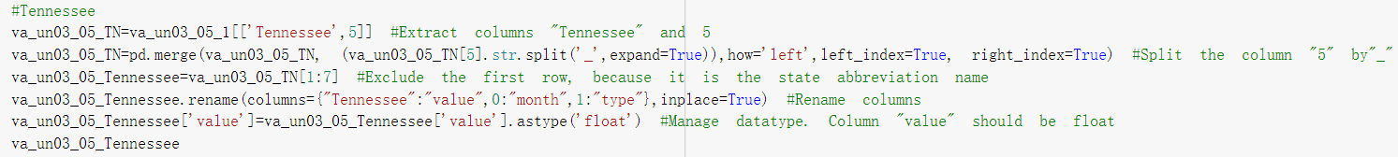
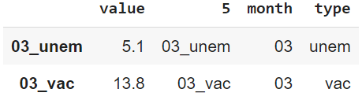
1
2
3
Extract States one at a time
Split columns (Month/Type)
Rename & Convert Data Type of the Column
4
5
Exclude Irrelevant Data
Separate vac and unem
Notes:
Then, we splitted column5 to get 2 variables for the X-axis and Y-axis, that is month and type.
The criteria is ”underline”, as marked in the blue box, so we get “unem” or ‘vac’ in each month, you can see the output in the screenshot below.

Slide 26
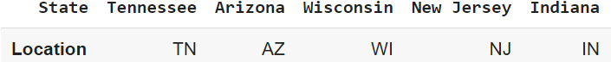
1
2
3
Extract States one at a time
Split columns (Month/Type)
Rename & Convert Data Type of the Column
4
5
Exclude Irrelevant Data
Separate Vac and Unem
Notes:
The third step is very straightforward, because the abbreviation name is useless, we just exclude it when drawing a plot.
The below screenshot is what we removed from our dataframe.

Slide 27
1
Extract States one at a time
4
2
Rename & Convert Data Type of the Column
Split columns (Month/Type)
5
3
Separate Vac and Unem
Exclude Irrelevant Data
Notes:
Next, we renamed our columns to make ourselves clear before we create the plot, also, we convert the datatype of column value, because it should be floating number instead of string.

Slide 28
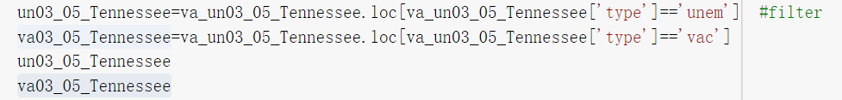
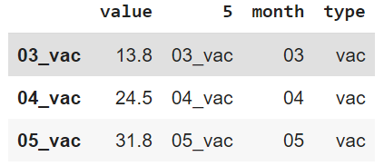
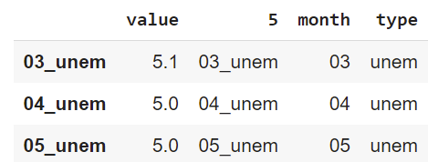
1
2
3
Extract States one at a time
Split columns (Month/Type)
Rename & Convert Data Type of the Column
4
5
Exclude Irrelevant Data
Separate Vac and Unem
Notes:
Finally we are almost done! We separated “unem’ and ‘vac’ to make separate line plot.
These two are the final results of our dataframe.

Slide 29
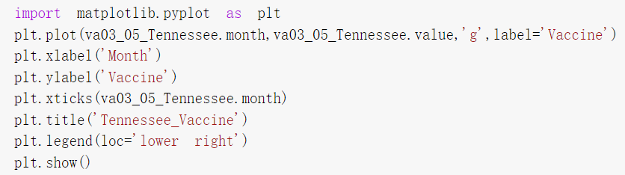
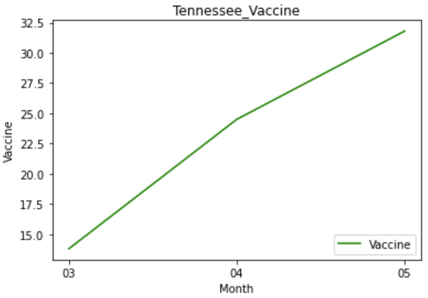
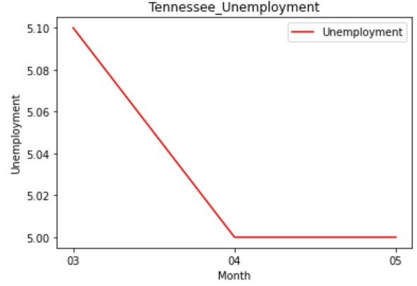
Notes:
Then we can use matplotlib to create our line plot, the X-axis is month, and the Y-axis is vaccination rate or unemployment rate.
Also, we put the legend label at lower right or upper right, because we don’t want to block our audience’s view.
You can see the vaccination rate is increasing in left plot, and unemployment rate is decreasing in right plot in Tennessee.

Slide 30
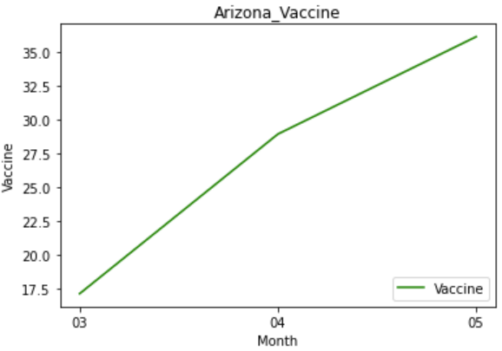
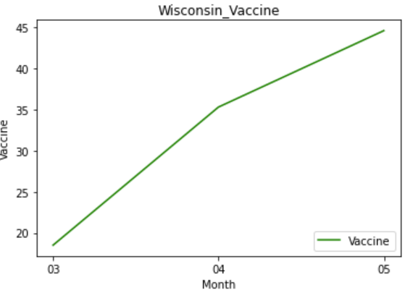
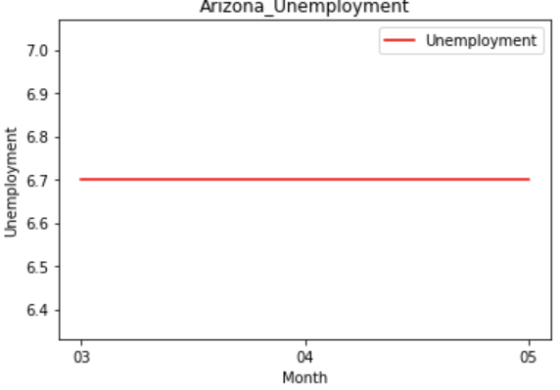
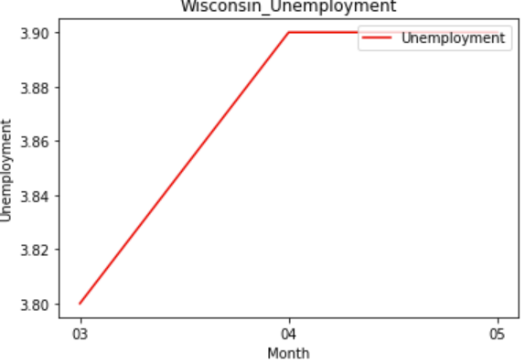
Notes:
And for the rest 4 states, we repeat our 5 steps to make 2 plots for everyone. Here come the plots of……
But do you remember that unemployment rate is decreasing in Tennessee, as this slide showed? We have different results in other states, for example, the rate is not changing in Arizona, and it is even increasing in Wisconsin.
One thing is that you can see in this unemployment rate plot, the numbers on Y-axis are very close, so any increase or decrease will cause obvious change with the line, but the gap between 3.8 and 3.9 is really small actually. Also, we will cover this later, that is to say we should put more factors into consideration when we discuss about the change.
But overall speaking, the increase in vaccine rate does not mean 100% decrease in unemployment rate in the same period.

Slide 31
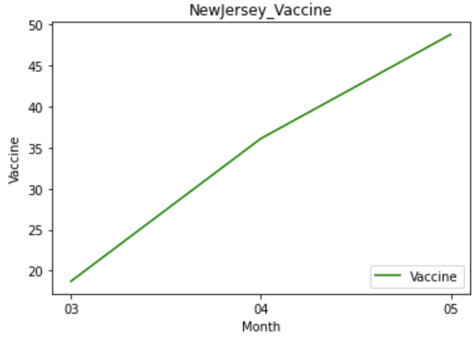
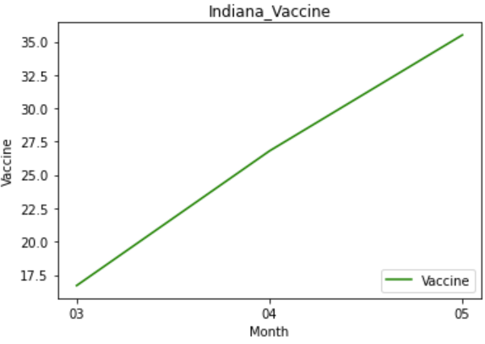
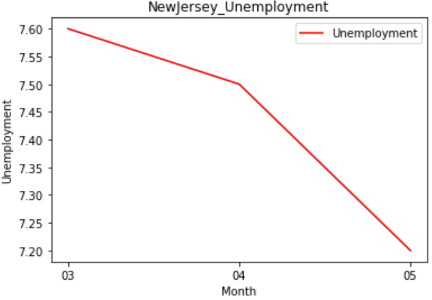
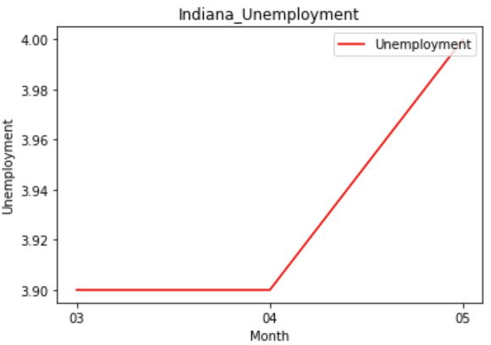

Slide 32
The relationship between
Unemployment and Vaccination Rate
is not clear.
Notes:
In our project, we focus on the problem: does vaccine help the economy?
So we analyze the data in five states, and after graphing the line chart, It’s not clear to see the relationship between unemployment and vaccination rate.

Slide 33
Conclusion
Jonna
1
Current vaccination data available on CDC only covered 3 months, there is limited data to analyze and easily affected by the result of single month
Also, we doubt that the unemployment rate was not affected immediately.
A longer period of observation would help us gain more evidence to verify the relationship between vaccination and unemployment rate.
Notes:
We concluded that because the current vaccination data available on CDC only cover 3 months from March to May, there is limited data to analyze and easily affected by the result of single month.
We also doubt that the unemployment rate was not affected immediately. And there might be some time delay to react. So, we thought that a longer period of observation would help us gain more evidence to verify the relationships.

Slide 34
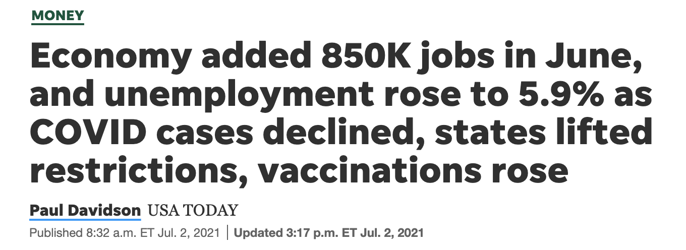
Notes:
Regarding the unemployment issue, we also find some latest news talking about that. The USA TODAY highlights last week that there are 8 hundred 50 thousand jobs added in June as covin cases declined, states lifted restrictions, and vaccinations rose, however the overall unemployment rose to 5.9%

Slide 35
Conclusion
Jonna
2
Correlation does not imply causation.
More parameters should be considered.
Notes:
Moreover, correlation does not imply causation. We only take two variables this time, more parameters should be considered in further analysis.

Slide 36
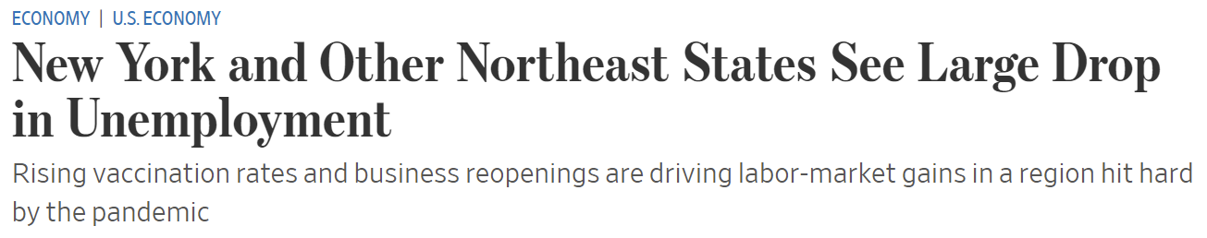
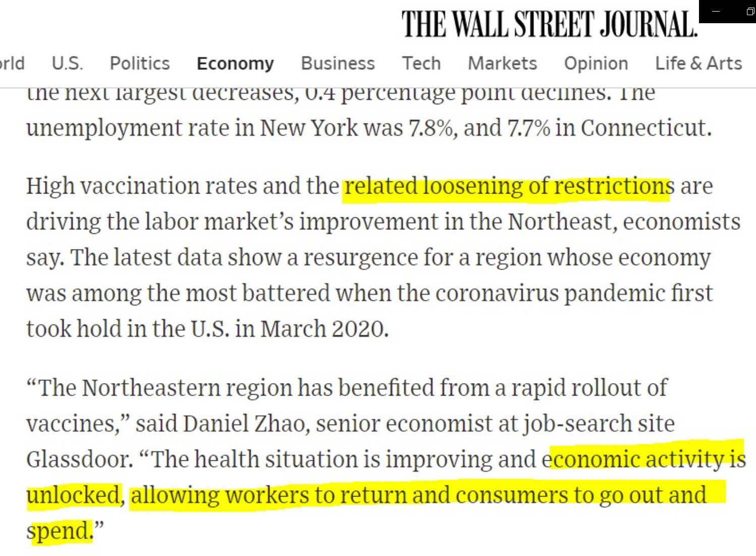
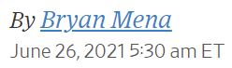
Notes:
What the wall street journal reported on June 26 also echo our conclusion
It highlight New York and other northeast states see large drop in the unemployment. not only high vaccination rates, but the related loosening of restrictions work as drivers of labor markets.
So there are a lot more variables to be considered in this problem.

Slide 37

Thank you
for your listening !
Jonna
Notes:
And this is our report, we are group 2. Thank you for your listening

Slide 38
Sources
Jonna
State-economic-monitor: https://apps.urban.org/features/state-economic-monitor/
CDC: https://covid.cdc.gov/covid-data-tracker/#compare-trends_totalcasesper100k
https://data.cdc.gov/Vaccinations/COVID-19-Vaccinations-in-the-United-States-Jurisdi/unsk-b7fc/data

